Slide 1


Face Mask Detection
MINI PROJECT PHASE-3
Presented by:
Akash S S (1DS18IS008)
Kedar Hegde (1DS18IS035)
Rahul B V (1DS18IS045)
Sandesh S Hegde (1DS18IS057)
Under The Guidance Of
LATHA A P
Assistant Professor
Dept. of Information Science
and Engineering
DSCE, Bangalore

Slide 2

Face Mask Detection

Slide 3
Abstract
The new Coronavirus disease (COVID-19) has seriously affected the world. To limit the spread of the disease, mandatory face-mask rules are now becoming common in public settings around the world. Additionally, many public service providers require customers to wear face masks under predefined rules (e.g., covering both mouth and nose) when using public services. These developments inspired research into automatic (computer-vision-based) techniques for face-mask detection to help monitor public behavior and contribute to constraining the COVID-19 pandemic.

Slide 4
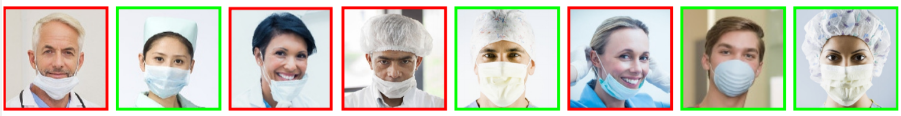
Introduction
Face-mask detection represents both detections as well as a classification problem because it requires first the location of the faces of people in digital images and then the decision of whether they are wearing a mask or not.
Example images from the MAFA dataset.

Slide 5

Problem Statement
Detect people that pass through a security-like camera and identify their face mask usage.

Slide 6
Existing System
The dataset has images having masked and unmasked human faces. An existing XML file helps us to detect faces from the image. Imported OpenCV reads an image and it returns an object of NumPy array by default and using img.shape we are checking the height and width of the image and it also returns 3 which is the color channel of the image.
Divide the dataset into ‘test’ and ‘train’. With the use of SVM algorithm, train a model.
The captured image is compared with the trained model which in turn gives the required output.

Slide 7

Proposed System
Face Mask Detection System uses existing IP cameras and CCTV cameras combined with Computer Vision to detect people without masks.
An existing XML file helps us to detect faces from the video.
A continuous video stream in which faces are detected using an XML classifier is compared with the trained model to verify whether the person is masked or not.

Slide 8

Hardware & Software Requirements
HARDWARE REQUIREMENTS
Desktop or Laptop with Windows/Linux/macOS having specs:
4 GB RAM (or higher).
Minimum of 2 GB of memory (HDD or SSD).
High-speed Internet Connection.
Integrated or a separate Webcam.
Graphics Card 512 MB (or higher).
Facemasks for testing.
SOFTWARE REQUIREMENTS
Python IDE (Spyder or PyCharm).
pip installer to install modules.
Modules like TensorFlow, Keras, NumPy, CV2, etc.
Haar Cascade Classifier

Slide 9
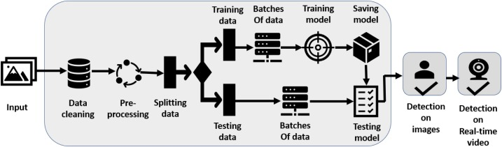
Architecture Diagram

Slide 10
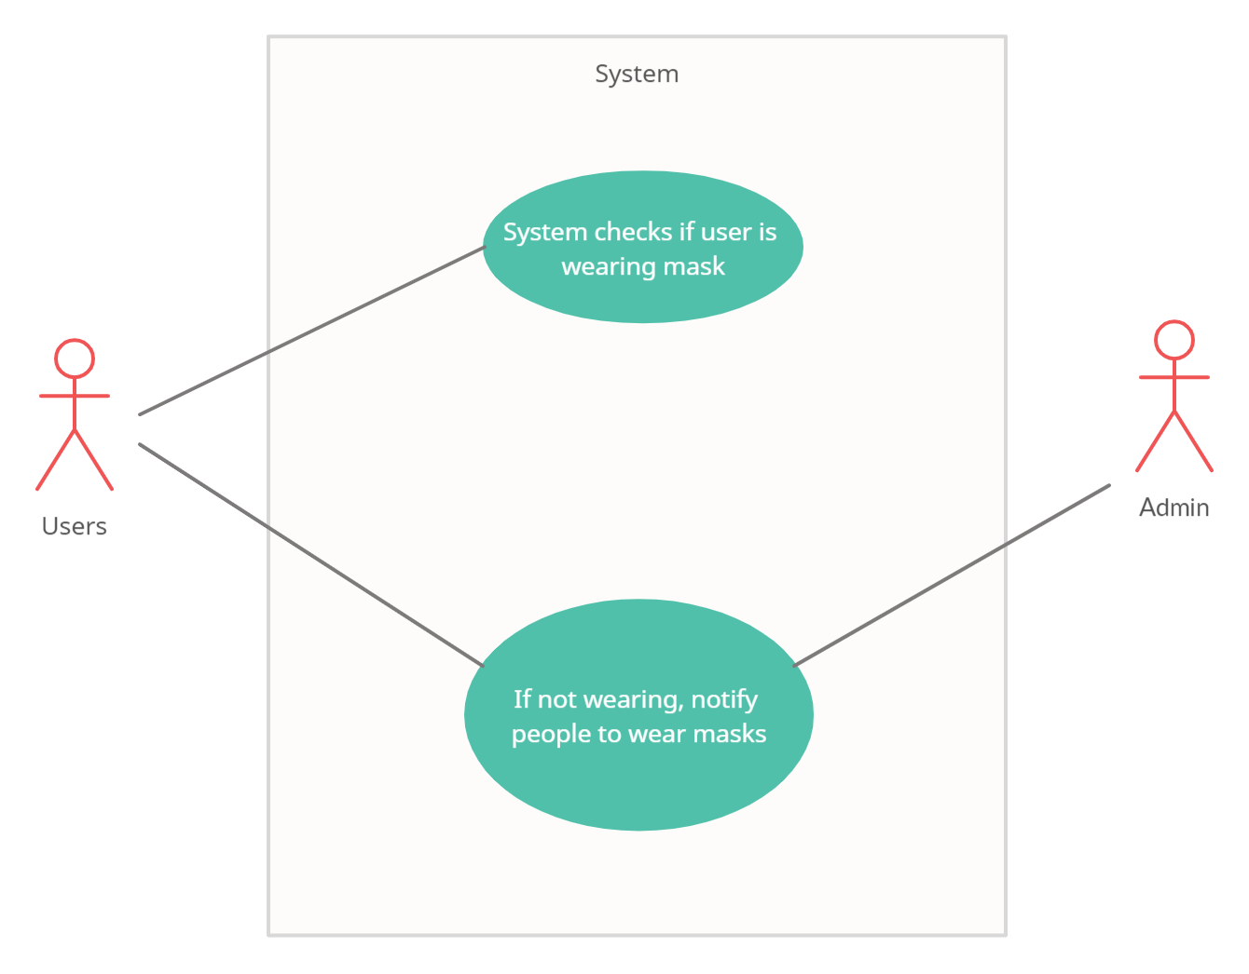
USE Case Diagram

Slide 11
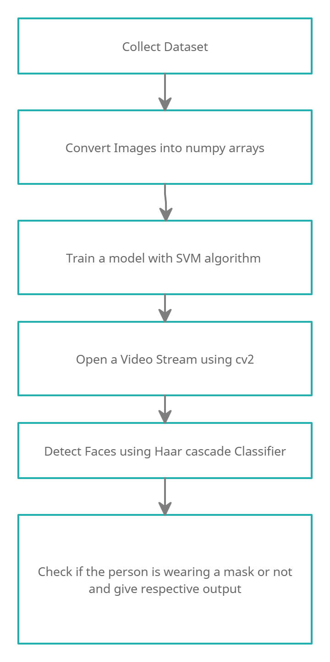
Sequence Diagram

Slide 12
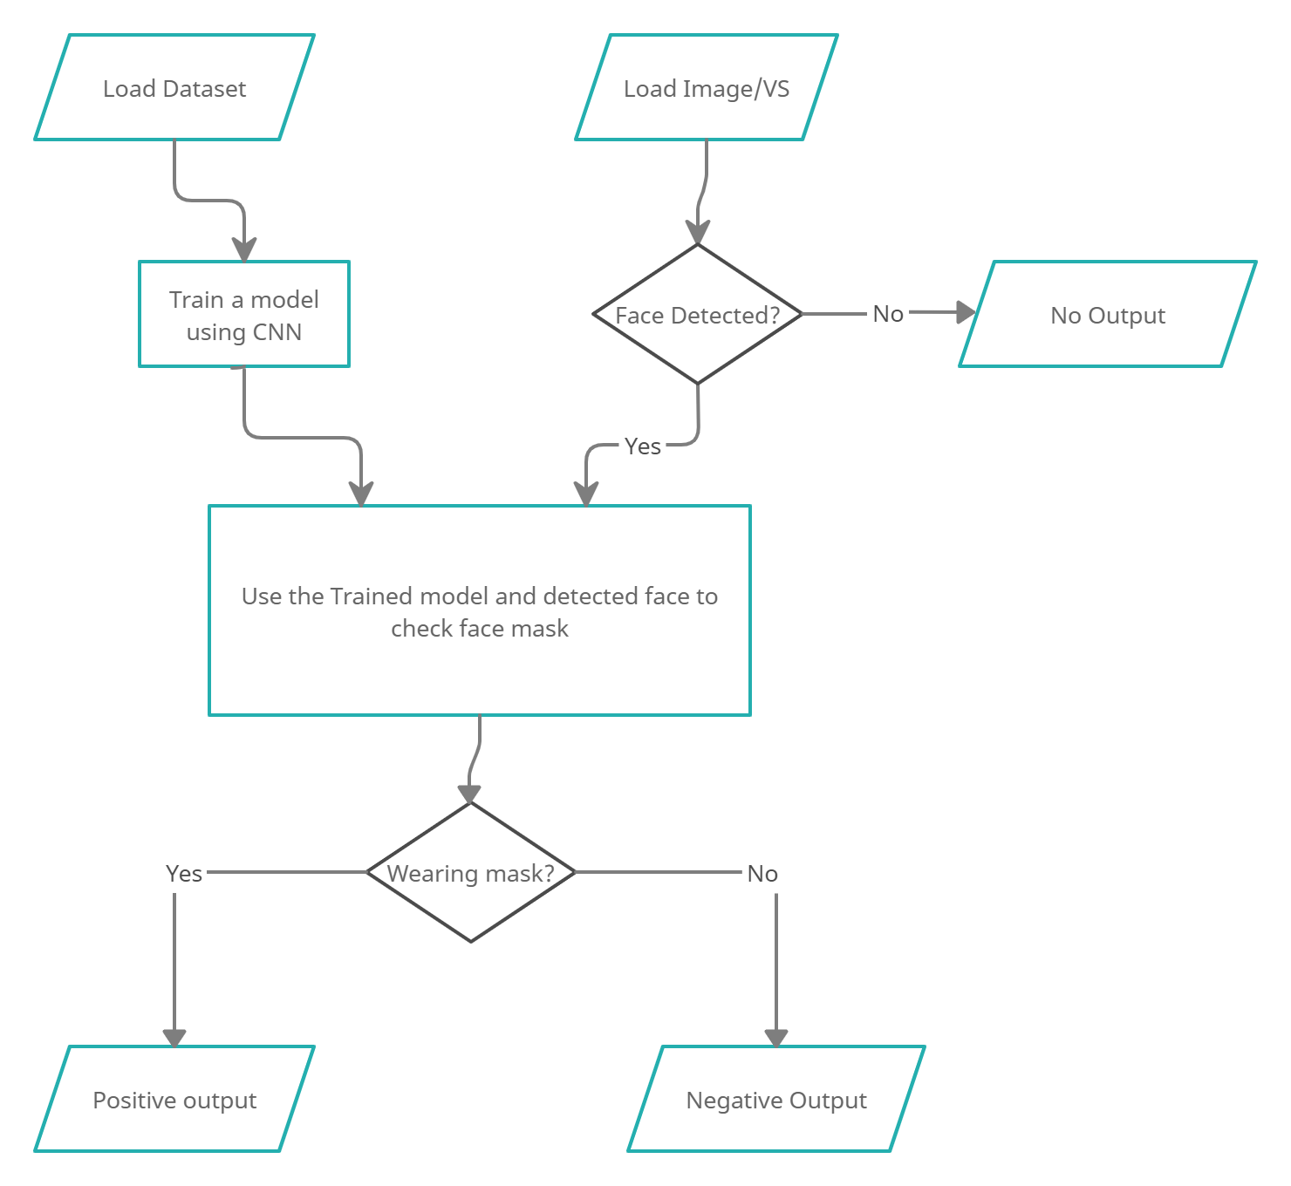
Flowchart

Slide 13
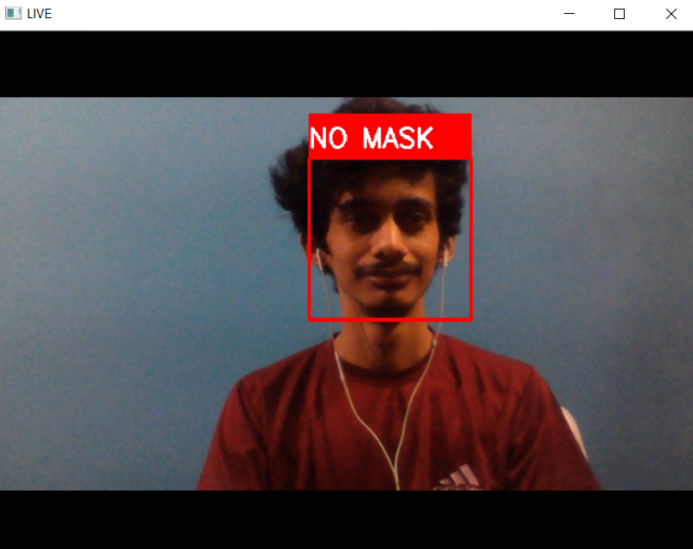
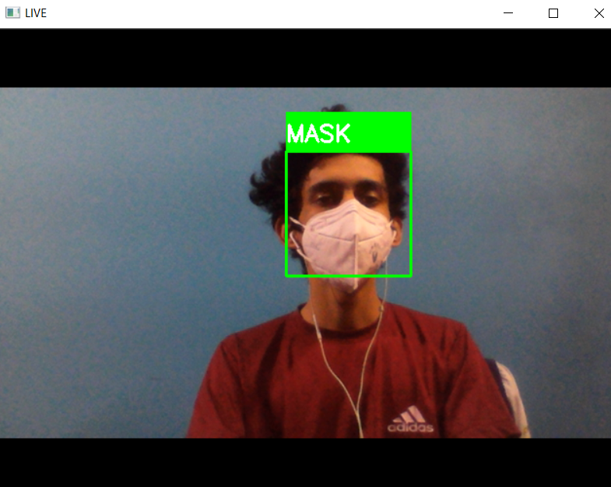
Results
Without Mask
With Mask

Slide 14
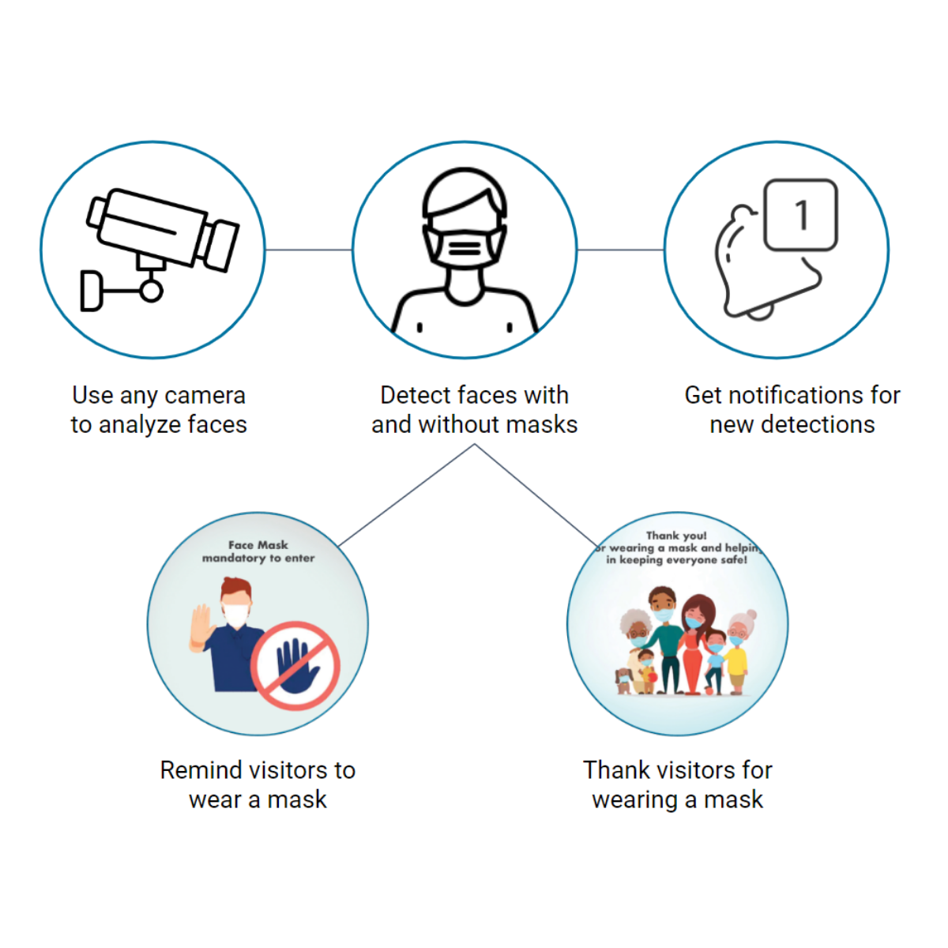
Project Outcomes and Future Enhancements
Outcomes
Start live streaming, detect faces and check if the Individuals and Crowd Wearing Masks.
Achieved Training accuracy of 97% and Validation accuracy of 95%.
Future Enhancements
Alert Staff When No Masks Are Detected - Distress Signal deployment.
Works With Existing USB Or IP Cameras With RTSP Streams.
Anonymous & Spoof Proof.

Slide 15

Conclusion
Since the COVID-19 pandemic has created a lot of chaos, wearing masks and preventing the spread of the virus should be one’s top priority. In social gatherings, people usually tend to loosen their masks for their comfort. This increases the spread of the virus.
It requires a lot of manpower to control the crowd and check if they’re wearing masks properly or not. Instead, we can use this project in order to alert the staff so that they can make people wear masks properly or keep a penalty so that people wear them properly. This reduces the spread of the virus which in turn brings an end to this pandemic.

Slide 16

References
World Health Organization. Coronavirus Disease (COVID-19): Advice for the public.
TensorFlow Documentation.
NumPy Documentation.
OpenCV Modules.
scikit-learn.

Slide 17


